Slide 1
Hardware Design
Part 1
UNT College of Engineering Maker Space
UNT Robotics
Presentator Tyler Adam Martinez

Slide 2
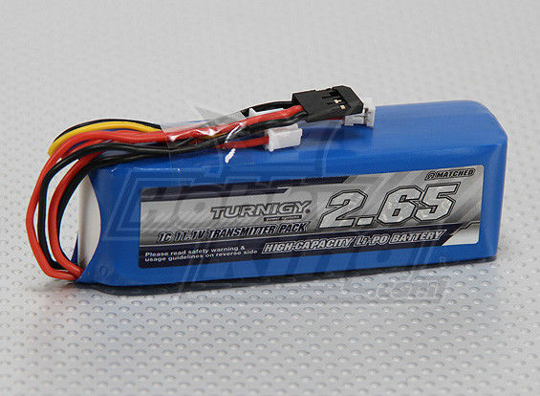
Source of Power
The most common source of power in robotics is a battery. Therefore, being power efficient is a top priority because once the battery dies, the robot dies.
Things to look for in a battery
Rechargeable
Cost effective
Voltage level
Current rating
Weight
Notes:
LIPO battery are used for rechargeable and cost effective

Slide 3
Distribution:
Converting Logic levels and Stepping down power
Voltage divider
Voltage regulator
Buck converter
Bidirectional logic converter
Stepping up Voltage
Boost Converter
Notes:
Draw schematic out on the whiteboard and talk about the advantages and disadvantages of each.
Please note that the bidirectional logic converter is for low level power conversion

Slide 4
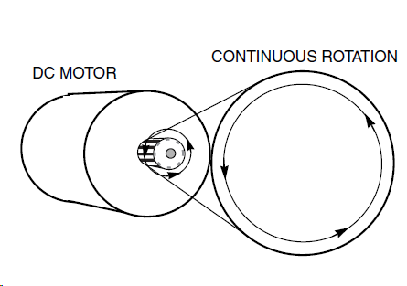
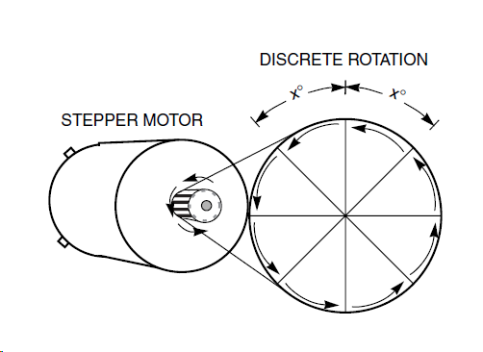
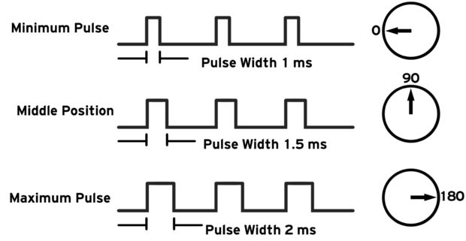
The motor types
DC MOTORS- CONTINUOUS Rotation
On the wheels to move the robot.
STEPPER- Discrete Rotation
Drive train
SERVO- LINEAR or ROTARY actuator.
Pulley system

Slide 5
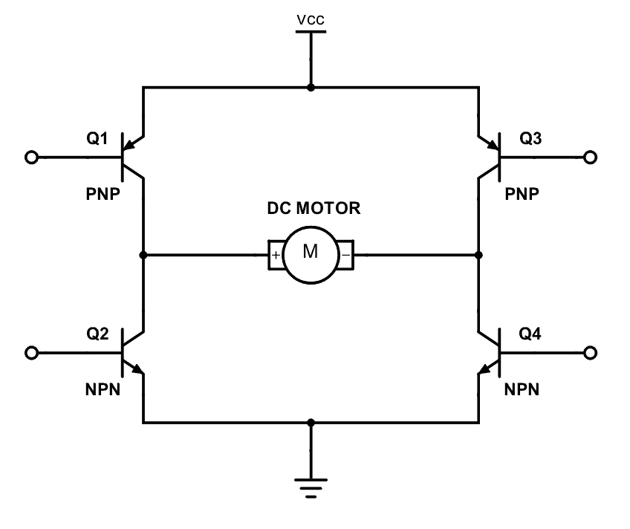
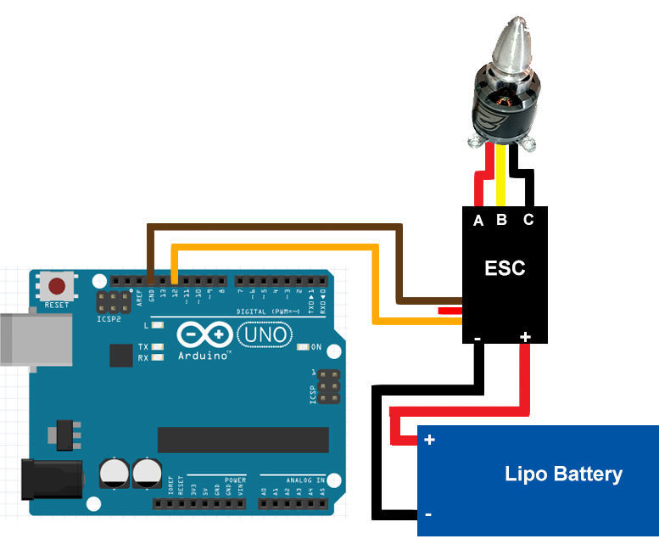
DC motor
Brush v. Brushless
H Bridge v. Electric Speed Controller (ESC)
Pulse Width Modulation (PWM)

Slide 6
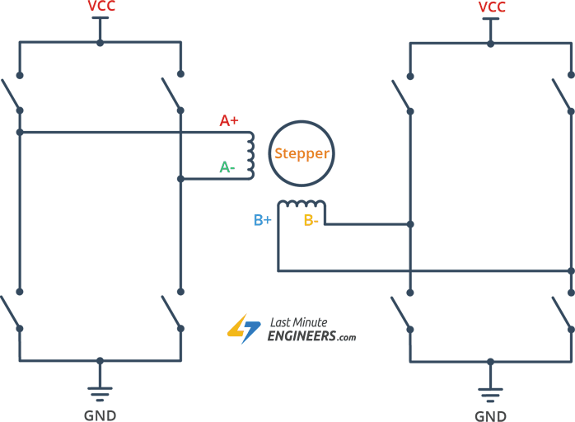
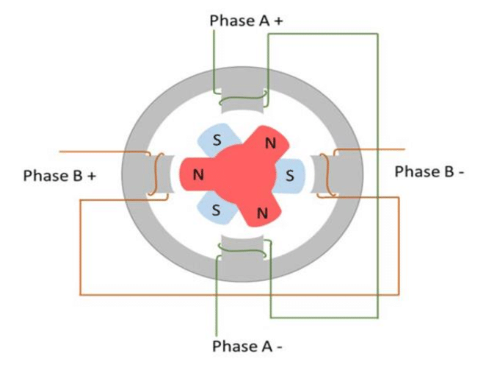
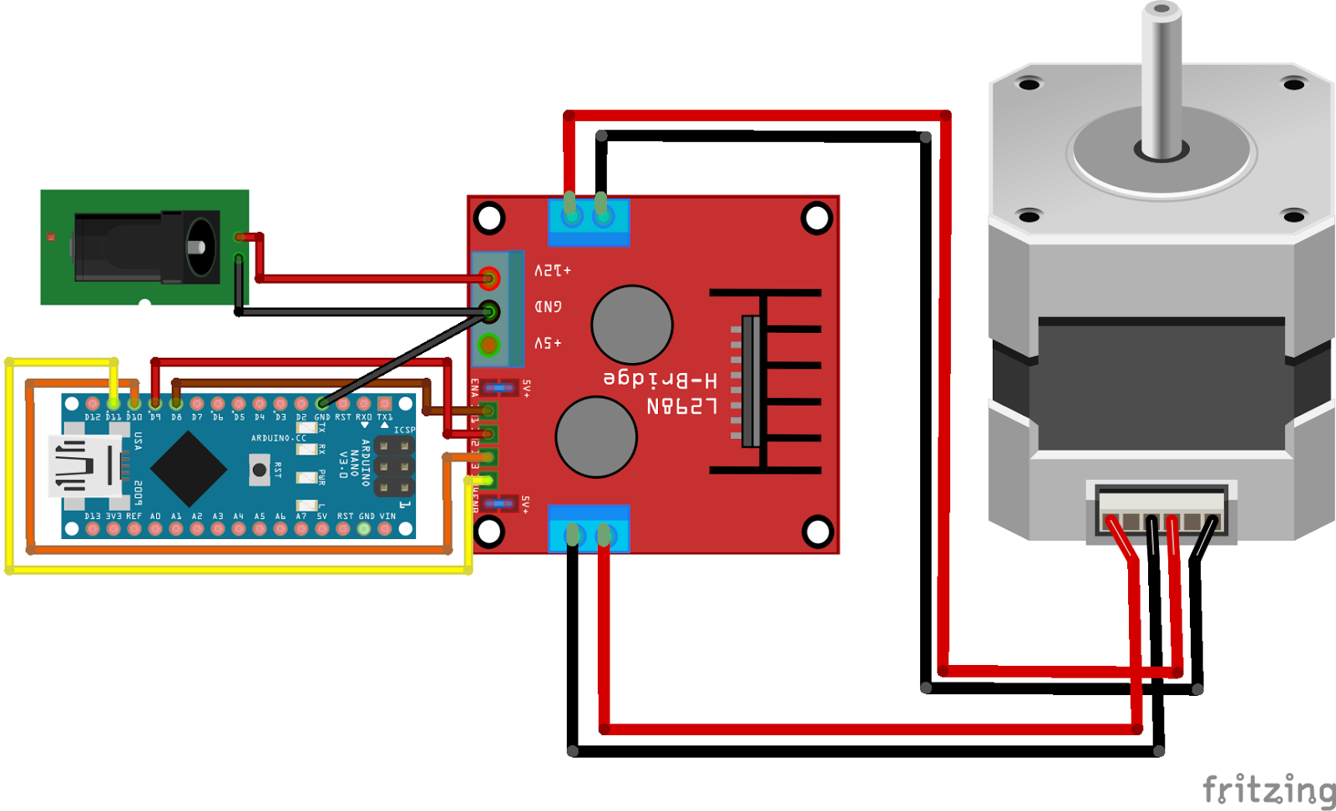
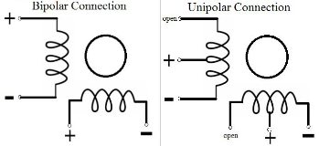
Stepper motor
Step Angle/Rotation
Bipolar v. Unipolar
Wave driving, Full step driving, mircostep driving
Common Ground
Notes:
These motor are very accurate and don’t like to spin if not told too.
Bipolar v. Unipolar
bipolar has higher torque than Unipolar
Unipolar is faster than the bipolar
Unipolar Simpler control circuit that bipolar because unipolar does not require reverse voltage to spin in the other directions
Internally there are 3 different types of designs
Variable Reluctance Stepper
Permanent Magnet Stepper
Hybrid Stepper (This is the most common type)
Types of driving
Wave driving is where only one coil is active
Full step driving is where where both coils are active creates a higher torque
Half step driving is where is both of the above methods to double to step rotations per revolution
#include <Stepper.h> for adriuno

Slide 7
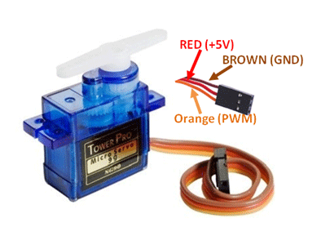
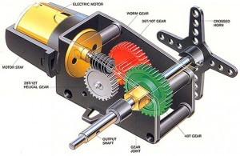
Servo motor
Gear Box
Slight Modification
Pulse Width Modulation (PWM)
Notes:
IT’s controlled using 50Hz PWM
Another common control frequency for the servo is 60Hz
#include <Servo.h> for ardiuno

Slide 8
Let’s draw it out,
and moves some motors !
Hardware Design Workshop part 1
Notes:
Beginning:
Wire a motor of their choosing (Servo, DC motor, or Stepper) with necessary drivers and control the output of the motor to spin at full speed for 2 seconds, then half speed 2 seconds, the off for 2 seconds. Then loop.
The code for the beginners will be writing for them on GitHub
Advanced:
I want them to draw a schematic including the Battery as the voltage source, draw a circuit to drive each of the three motor types, have to battery power the microprocessor and and power one of the motor of their choosing. Also, write the program to themselves.

